Slide 1
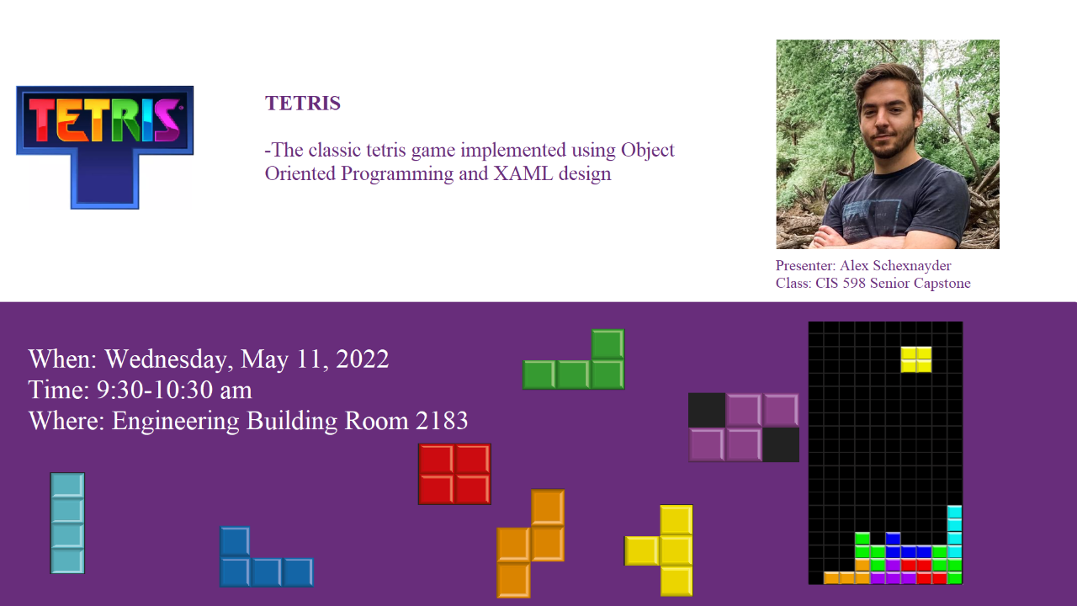

Slide 2
Presentation Outline
History of Tetris
My Implementation
Tools
Code
UML Design
Use Case Sequence Diagram
Time Spent
Demo
Future Project Goals
Questions?

Slide 3
History of Tetris
Created by Soviet software engineer Alexey Pajitnov in 1984
Currently available on over 65 different gaming platforms
Hundreds of different versions
One of the top best-selling video games of all time
Over 202 million copies sold by December of 2011
Has often been subject to numerous research studies that have analyzed its theoretical complexity and its effect on the human brain, including the “Tetris Effect”

Slide 4
My Implementation

Slide 5




Tools
Languages
Environment
Source Control

Slide 6

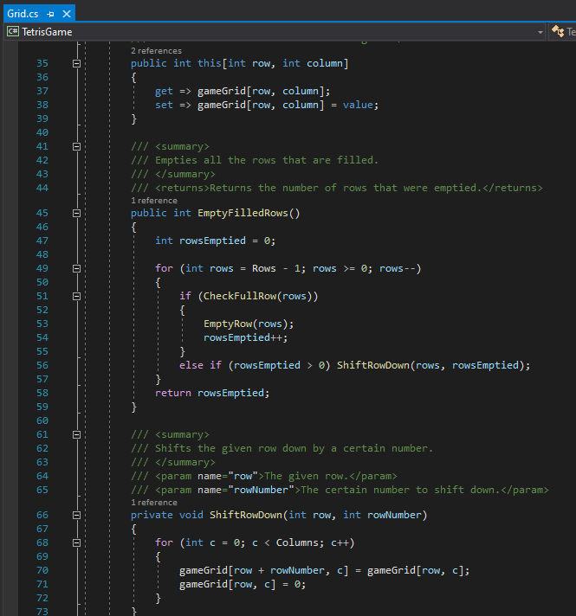
Grid Class

Slide 7
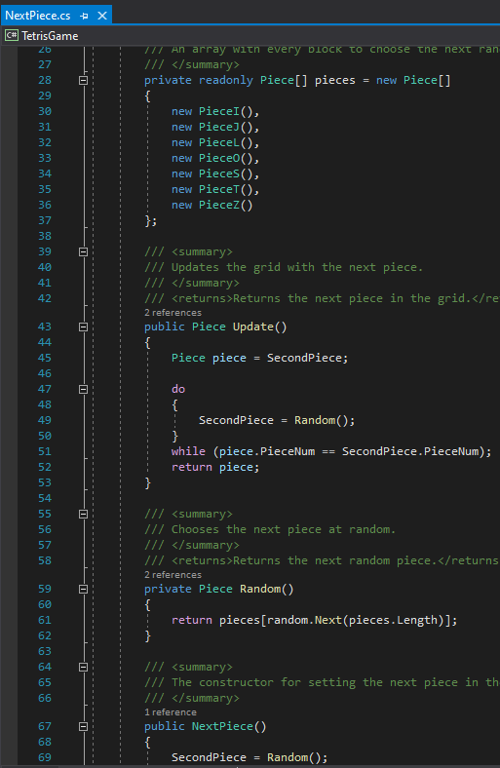
Next Piece Class

Slide 8
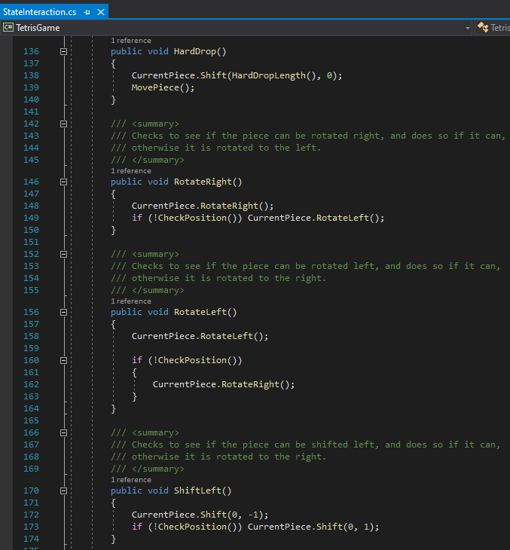
State Interaction Class

Slide 9
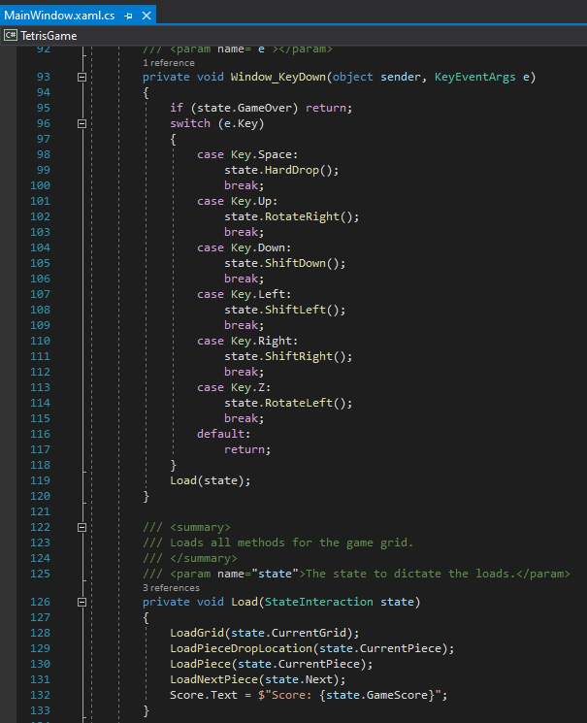
Main Window

Slide 10
UML Design

Slide 11
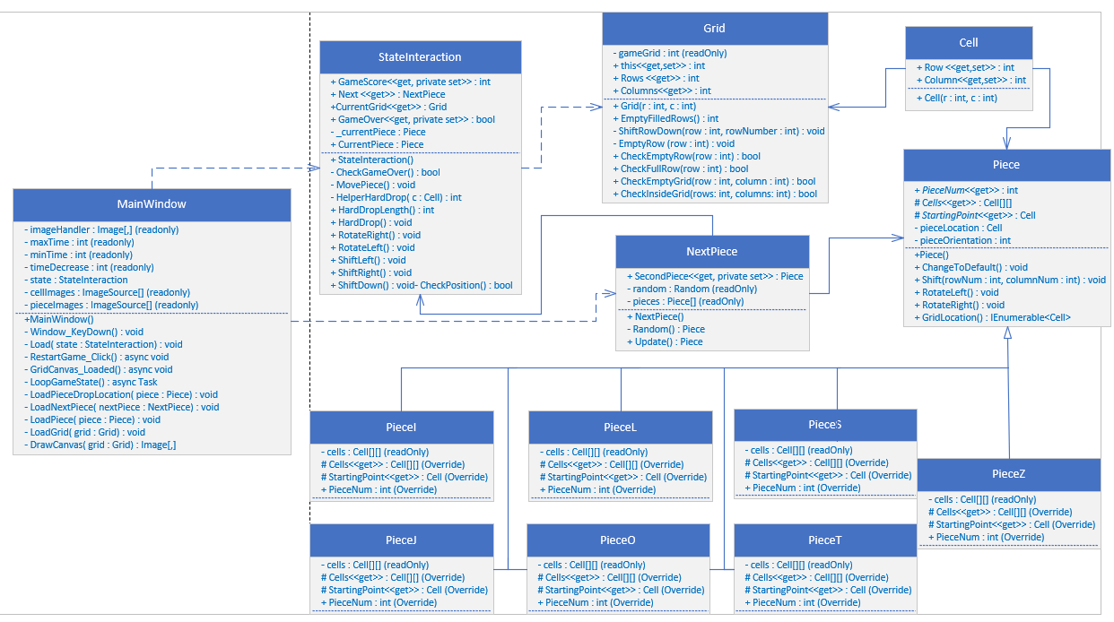

Slide 12
Use Case Sequence Diagram

Slide 13
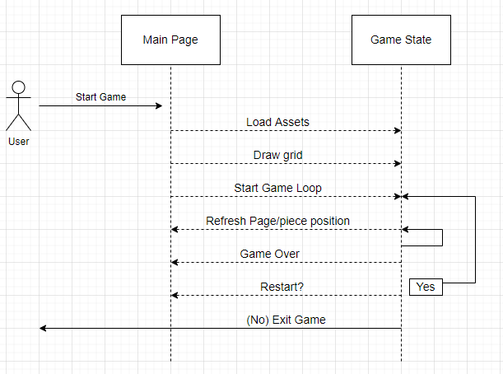

Slide 14
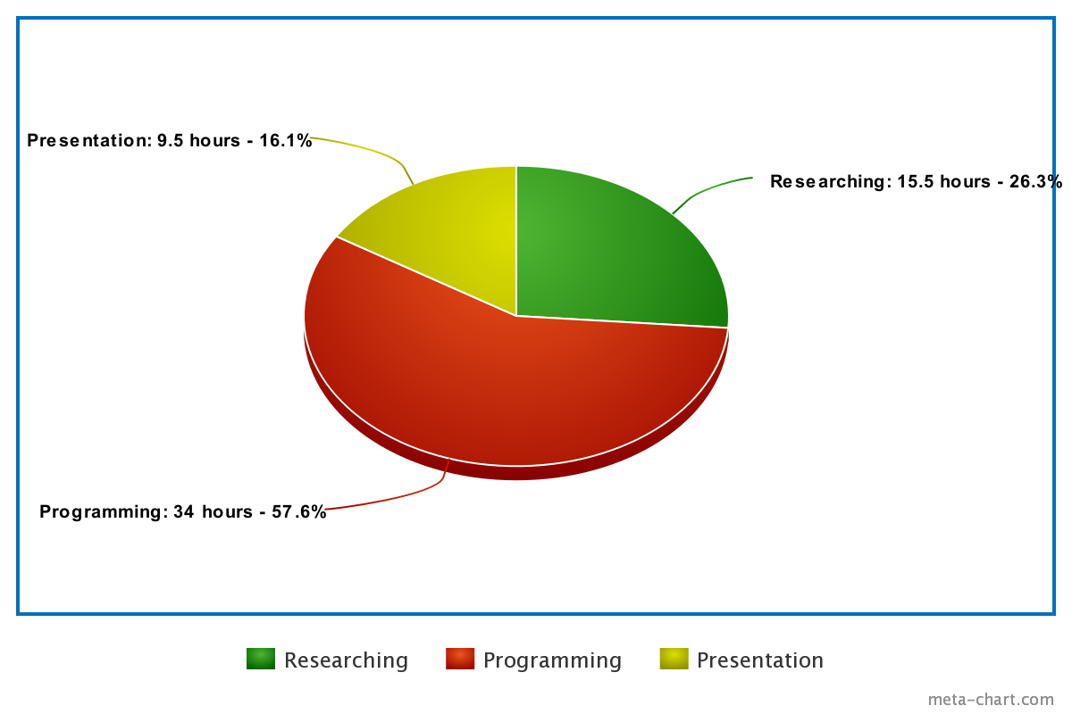
Time Spent

Slide 15
Demo

Slide 16
Future project goals
Possible separate game modes from traditional Tetris
High Score tracking
Will need to create game instances to track final score from each game
Log in functionality
Will track multiple different users and their scores from previous games with date and score stamps on a separate page

Slide 17
Questions?

